Slide 1
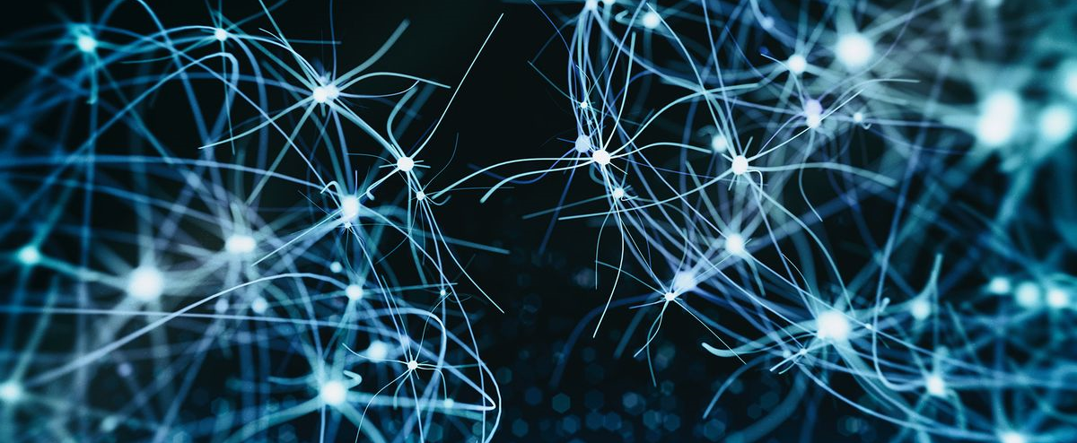

BMB3015 ARTIFICIAL INTELLIGENCE
PROBABILISTIC REASONING & BAYESIAN NETWORKS

Slide 2
Bayesian Networks
A simple, graphical notation for
conditional independence assertions and
compact specification of full joint distributions.
Syntax:
a set of nodes, one per variable
a directed, acyclic graph (link ≈ "directly influences")
a conditional distribution for each node, given its parents:
P (X_{i} | Parents (X_{i}))
In the simplest case, conditional distribution is represented as a conditional probability table (CPT) giving the distribution over X_{i} for each combination of parent values

Slide 3
Bayesian Network Example
Peter is at work,
neighbor John calls to say his alarm is ringing, but neighbor Mary doesn't call.
Sometimes it's set off by minor earthquakes.
Is there a burglar?
Variables:
Burglary (B), Earthquake (E), Alarm (A), JohnCalls (J), MaryCalls (M)
Network topology reflects "causal" knowledge:
A burglar can set the alarm off
An earthquake can set the alarm off
The alarm can cause Mary to call
The alarm can cause John to call

Slide 4
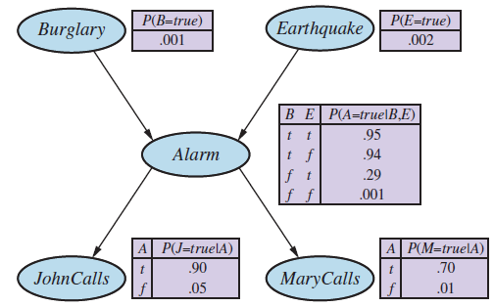
Bayesian Network Example

Slide 5
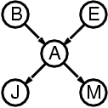
Compactness
A CPT for Boolean X_{i} with k Boolean parents has
2^{k} rows for the combinations of parent values
Each row requires one number p for X_{i} = true (the number for X_{i} = false is just 1-p)
If each variable has no more than k parents, the complete network requires O(n · 2^{k}) numbers
i.e., grows linearly with n, vs. O(2^{n}) for the full joint distribution
for burglary net, 1 + 1 + 4 + 2 + 2 = 10 numbers (vs. 2⁵-1 = 31)

Slide 6
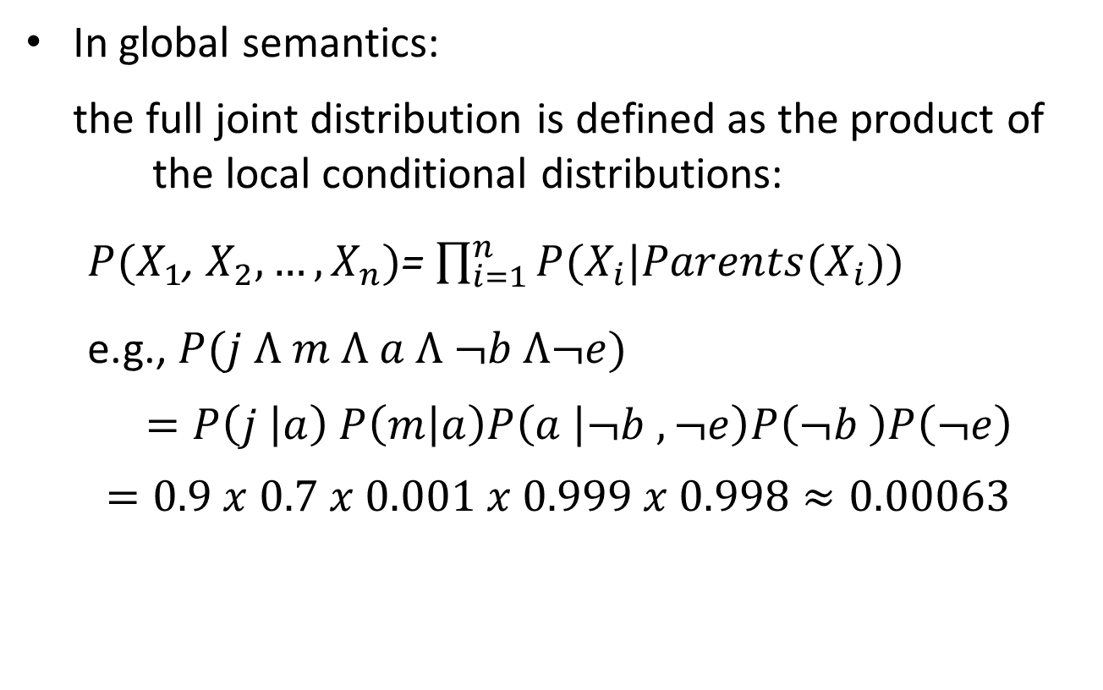
Global Semantics
In global semantics:
the full joint distribution is defined as the product of the local conditional distributions:
$P(X_{1}$, $X_{2},…,X_{n})$= $\prod_{i=1}^{n}{P(X_{i}|Parents(X_{i}))}$
e.g., $P(j Ʌ m Ʌ a Ʌ ¬b Ʌ¬e)$
$=P\left(j | a\right) P\left(m | a\right)P\left(a | ¬b ,¬e\right)P\left(¬b \right)P\left(¬e\right)$
$$=0.9 x 0.7 x 0.001 x 0.999 x 0.998≈0.00063$$

Slide 7
Bayesian Network Example

Slide 8
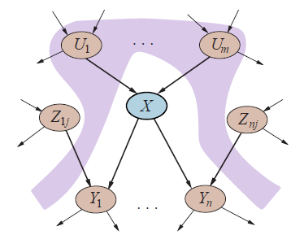
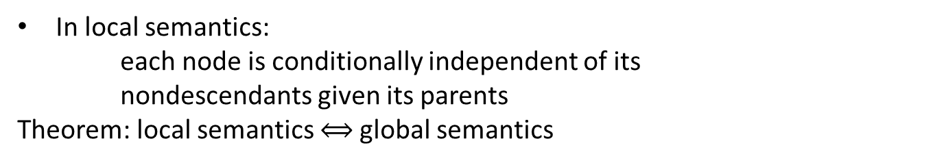
Local Semantics
In local semantics:
each node is conditionally independent of its
nondescendants given its parents
Theorem: local semantics $⟺$global semantics
Notes:
Descendants->neslinden olan, torun
Nondescendant-> neslinden olmayan

Slide 9
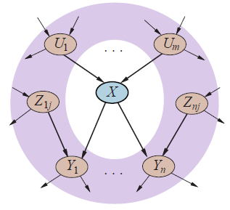
Markov Blanket
Each node is conditionally independent of all others given its Markov blanket
Markov blanket:
parents + children + children's parents

Slide 10
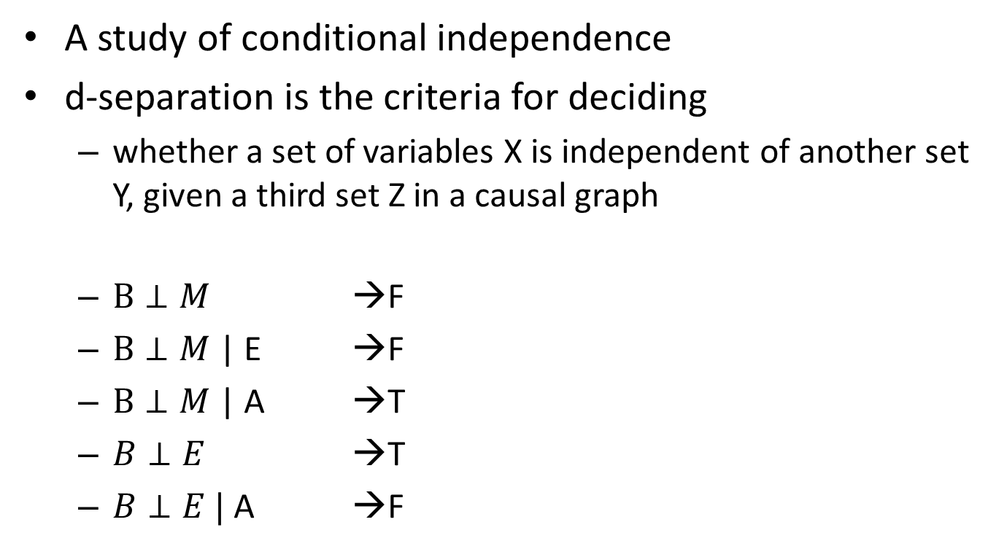
d-Separation
A study of conditional independence
d-separation is the criteria for deciding
whether a set of variables X is independent of another set Y, given a third set Z in a causal graph
$B⊥M$ →F
$B⊥M$ | E →F
$B⊥M$ | A →T
$B⊥E$ →T
$B⊥E |$A →F

Slide 11
Active (Dependent) Triplets
A,B,C -> dependent
A,B,C -> dependent
A,C |B -> dependent
A
B
C
B
A
C
A
C
B
KNOWN

Slide 12
Active (Dependent) Triplets
Knowing X will affect all above variables and make them dependent,
A, B, C | X -> dependent
A
C
B
.
.
.
X
KNOWN

Slide 13

Inactive (Independent) Triplets
A$⊥$C |B
A$⊥$C |B
A$⊥$C
A
B
C
B
KNOWN
A
C
A
C
B

Slide 14
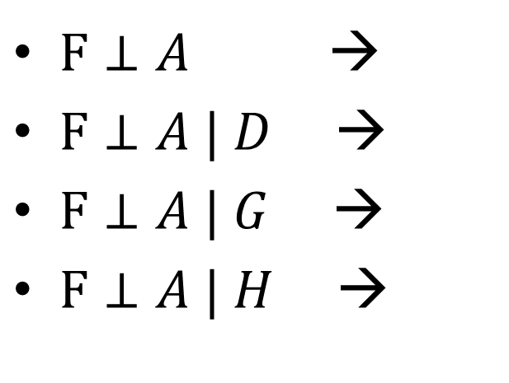
d-Separation Example
A
C
F
B
E
D
H
$F⊥A$ →
$F⊥A | D$ →
$F⊥A | G$ →
$F⊥A | H$ →
T
F
F
T
G

Slide 15
Constructing Bayesian Networks
Choose an ordering of variables X₁ , … , X_{n}
for i = 1 to n
add X_{i} to the network
select parents from X₁ , … ,X_{i-1} such that
P (X_{i} | Parents(X_{i} )) = P (X_{i} | X₁ , ... , X_{i-1})

Slide 16
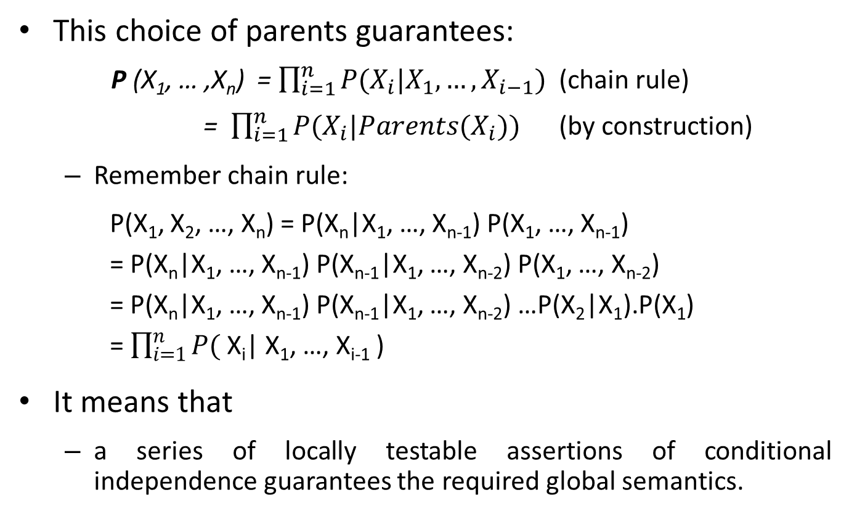
Constructing Bayesian Networks
This choice of parents guarantees:
P (X₁, … ,X_{n}) = $\prod_{i=1}^{n}{P(X_{i}|X_{1},…,X_{i−1})}$ (chain rule) = $\prod_{i=1}^{n}{P(X_{i}|Parents(X_{i}))}$ (by construction)
Remember chain rule:
P(X₁, X₂, …, X_{n}) = P(X_{n}|X₁, …, X_{n-1}) P(X₁, …, X_{n-1})
= P(X_{n}|X₁, …, X_{n-1}) P(X_{n-1}|X₁, …, X_{n-2}) P(X₁, …, X_{n-2})
= P(X_{n}|X₁, …, X_{n-1}) P(X_{n-1}|X₁, …, X_{n-2}) …P(X₂|X₁).P(X₁)
= $\prod_{i=1}^{n}{P(}$ X_{i}| X₁, …, X_{i-1} )
It means that
a series of locally testable assertions of conditional independence guarantees the required global semantics.

Slide 17
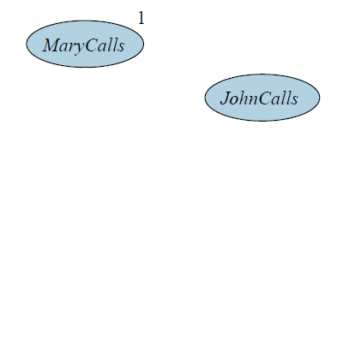
Constructing Bayesian Networks Example
Suppose we choose the ordering M, J, A, B, E
P(J | M) = P(J)?

Slide 18
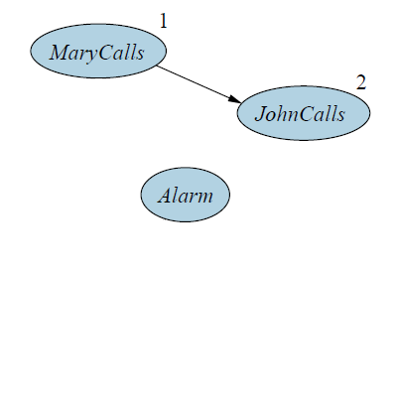
Constructing Bayesian Networks Example
Suppose we choose the ordering M, J, A, B, E
P(J | M) = P(J)? No
P(A | J, M) = P(A | J)? P(A | J, M) = P(A)?

Slide 19
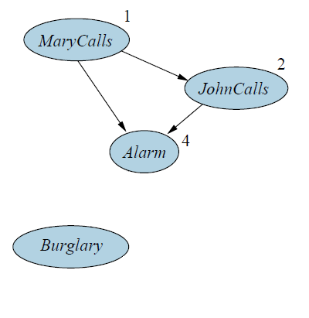
Constructing Bayesian Networks Example
Suppose we choose the ordering M, J, A, B, E
P(J | M) = P(J)? No
P(A | J, M) = P(A | J)? P(A | J, M) = P(A)? No
P(B | A, J, M) = P(B | A)?
P(B | A, J, M) = P(B)?

Slide 20
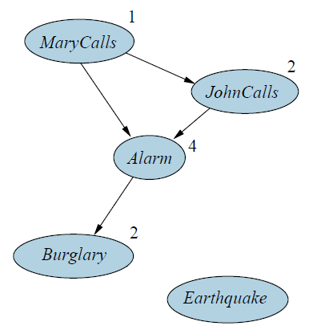
Constructing Bayesian Networks Example
Suppose we choose the ordering M, J, A, B, E
P(J | M) = P(J)? No
P(A | J, M) = P(A | J)? P(A | J, M) = P(A)? No
P(B | A, J, M) = P(B | A)? Yes
P(B | A, J, M) = P(B)? No
P(E | B, A ,J, M) = P(E | A)?
P(E | B, A, J, M) = P(E | A, B)?

Slide 21
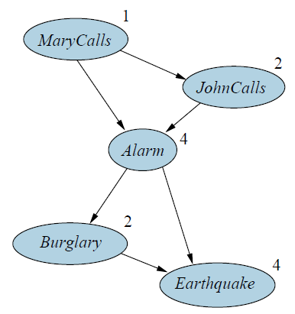
Constructing Bayesian Networks Example
Suppose we choose the ordering M, J, A, B, E
P(J | M) = P(J)? No
P(A | J, M) = P(A | J)? P(A | J, M) = P(A)? No
P(B | A, J, M) = P(B | A)? Yes
P(B | A, J, M) = P(B)? No
P(E | B, A ,J, M) = P(E | A)? No
P(E | B, A, J, M) = P(E | A, B)? Yes

Slide 22
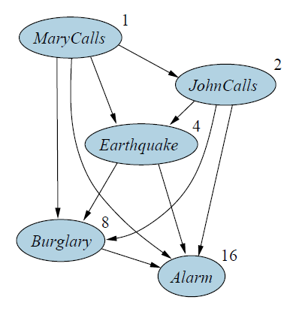
Constructing Bayesian Networks Example
Deciding conditional independence is hard in noncausal directions Causal models and conditional independence seem hardwired for humans! Network is less compact:
1 + 2 + 4 + 2 + 4 = 13 numbers needed
1 + 2 + 4 + 8 + 16 = 31 numbers needed
1 + 1 + 4 + 2 + 2 = 10 numbers in original network
Notes:
Hardwired: bütünleşik

Slide 23
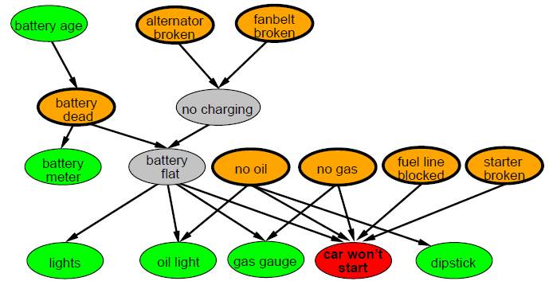
Example: Car Diagnosis
Initial evidence: car won't start
Testable variables (green)
«broken, so fix it» variables (orange)
Hidden variables (gray)
ensure sparse structure,
reduce parameters
Notes:
Dipstick: yağ çubuğu
Gauge: gaz ölçümü
Fanbelt: soğutucu fan kayışı

Slide 24
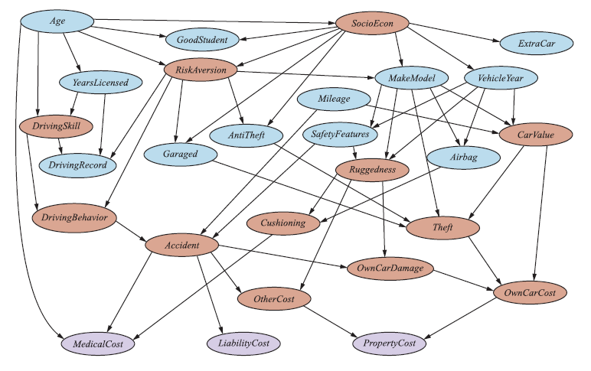
Example: Car Insurance

Slide 25
Summary
Bayesian networks provide a natural representation for causally induced conditional independence
Topology + CPTs = compact representation of joint distribution
Generally easy for domain experts to construct

Slide 26
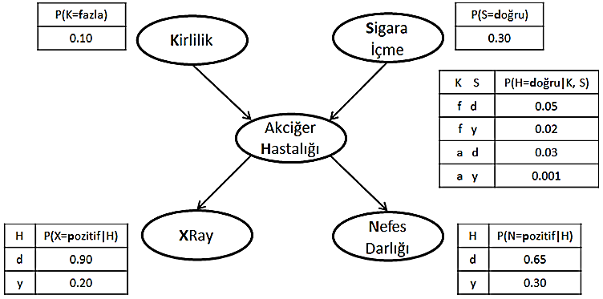
Bayesian Network Problem
P(X=p, N=n, H=d, S=d, K=a) = ?
P(X=p) = ?
P(H=d | N=p) = ?
P(H=d | S=d) = ?

